Slide 1
Nairobi Smart parking system
Final year project presentation

Slide 2
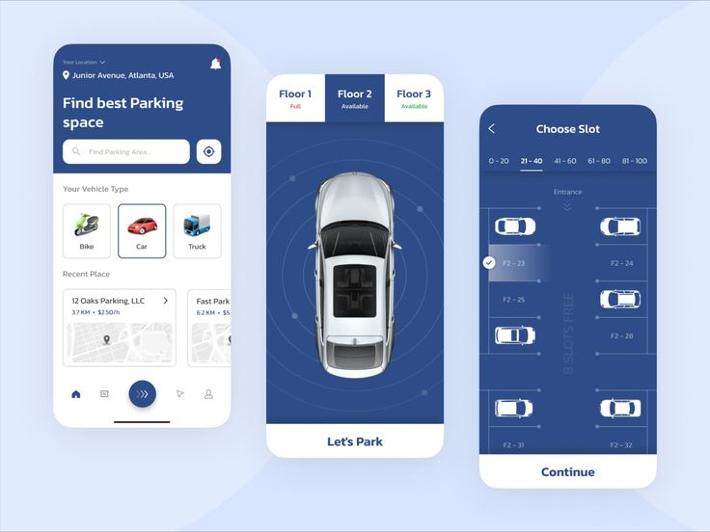
INTRODUCTION
Parking shortages and insufficient space utilization in growing urban areas lead to prolonged searches, increased emissions, and traffic congestion, highlighting the critical need for smarter solutions.
This project leverages IoT, sensors, and cloud-based platforms to provide real-time parking availability and improve traffic conditions.
It will also generate data insights to aid urban planning and support the development of scalable, future-ready infrastructure.

Slide 3

Problem Statement
Current System Limitations
Current parking systems rely on outdated, static methods that lack real-time data and fail to meet the demands of modern, high-traffic environments.
Overall Problem
There is a lack of IoT-enabled, data-driven parking solutions that optimize space usage, reduce congestion, and provide real-time availability updates, leading to widespread inefficiency, increased emissions, and economic losses.

Slide 4
Proposed Solution
The proposed solution is an IoT Smart Parking System that uses real-time monitoring, predictive analytics, and dynamic pricing to optimize parking space usage and reduce congestion.
It will include features like IoT-enabled sensors for real-time parking availability, a mobile application for driver assistance with automated payments, and machine learning algorithms for demand prediction and proactive management.
Additionally, the system will provide valuable data insights to city planners, enabling better urban mobility and sustainable infrastructure development.

Slide 5
OBJECTIVES
General Objective:
Develop an IoT-enabled Smart Parking System for real-time monitoring, predictive analytics, and optimized parking management to reduce congestion and enhance urban planning.
Specific Objectives:
Analyze global smart parking systems to identify optimal IoT solutions.
Develop a comprehensive IoT Smart Parking System architecture.
Deploy a prototype integrating IoT sensors, a mobile app, and a cloud-based platform.
Test and evaluate system effectiveness in reducing parking time and optimizing usage.

Slide 6
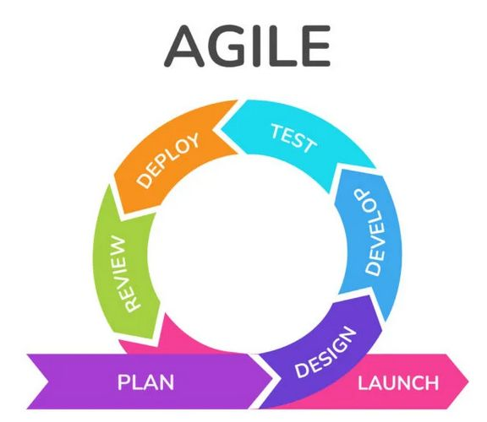
Methodology
Agile Methodology.
Why? For constant adjustments based on user feedback, evolving requirements, and real-time data integration.
Requirement gathering
Deployment and feedback
Design and prototyping
Iteration and optimization
Incremental development
Testing and evaluation

Slide 7
Expected Results
Real-Time Parking Data Integration: The system accurately updates parking availability, allowing users to view open spots instantly, reducing idle driving and improving urban mobility.
User-Centric Design: Through a responsive mobile app interface and web portal, the system provides a seamless and accessible experience for both users and administrators.
Scalability and Flexibility: The system architecture supports scalability, allowing additional parking locations to be integrated with ease, which is critical for growing urban parking demands.
Enhanced Data Security: The system incorporates encryption and access controls, mitigating risks associated with data breaches and maintaining user trust.

Slide 8
Gantt Chart
 | H1 |  |  | H2 |  |  | H3
 | Sept | Oct | Nov | Dec | Jan | Feb | March
Planning and problem Definition
Requirement Identification
Design system architecture
Proposal writing and approval
Designing application
Testing and updates
Implementation

Slide 9
BUDGET
Item | Price
laptop | 20000
Internet | 2000
transport | 5000
Backend Development: Uses Python with Django for managing business logic, real-time data, and secure web development. MongoDB and Redis handle data storage and real-time processing.
Middleware Layer: Employs MQTT for IoT communication and Kong as an API gateway for security and scalability.
Frontend Development: Utilizes Vue.js for a flexible and interactive user interface and Flutter for mobile app development with a native experience.

Slide 10
THANK YOU

